Slide 1


Exploring Integrative Multidisciplinary (IMD) research in 21st century regional history: The case of the Bekkersdal community in the West Rand mining region of South Africa, 1945-2013
Elize van Eeden
Regional Studies Association Global Conference
Fortaleza, Brazil
28 April 2014
Notes:
<number>

Slide 2
Outline
A concise view on regional history studies in IMD research;
A current IMD research project in Bekkersdal: as community in a "post-mining" context and a typical vulnerable place;
Thoughts about the value of being informed on the history of the Bekkersdal region to progress towards doing constructive IMD research on (for example) the area’s ecohealth and wellbeing status.

Slide 3
IMD-research based on a combination of integrative-like models, as developed by theorists like Basarab Nicolescu, Ken Wilber, Julie Klein and Gertrude Hirsch-Hadorn. The integrative disciplinary nature of regional history as observed by traditional practitioners like Finberg & Skipp are not ignored.
IMD research and regional history
Regional history research in essence features the COVERING OF A PRTICULAR FIELD in a region or area, debating a PARTICULAR PHENOMENON within this AREA or SPACE, and describing these in an area’s development in a very SPECIFIC TIME FRAME
Topics/Themes
World 2
Scientific inquiry
Bodies of knowledge
Phenomena
Space-Time- Geography
Socio-political context
World 1
The “real” world

Slide 4
Some fields of study Regional history - Local - Rural - Urban - Townships - Family - Community - People - Public - Environment - Place - Space - Area - Heritage | Some themes as broad/refined fields of study - Settlement patterns - Local governance & management patterns/issues - Urbanisation - Social structures and cultural patterns - Political trends - Demographic patterns - Infrastructural features - Industrialisation - Economic trends - Agricultural patterns - Ecohealth patterns Human well-being Human resilience - Education development - Communication patterns - Heritage and tourism development - Spiritual practices - Law, order and military impacts - Land - Environmental crises - Conservation… | Considerations for focussed research as phenomena in theme(s) of study(ies) - Growth, decline and change - Indigenous knowledge systems - Race (all-inclusive and/or specific) - Class (all-inclusive and/or specific) - Gender (all-inclusive and/or specific) - Identity - Relations (e.g. colonial; public versus private sector) - Policy issues - Poverty Environmental destruction and/or remediation and/or other issues Community engagement - Regionalisation - Globalisation… |  | Research methodology possibilities during the process of doing research - Recording knowledge systems - Philosophical - Archaeological - Social/modern social - Integrative Multidisciplinary - Perspectives from the bottom up and top down - Mixed methods …
A concise view on IMD research in regional history studies
Notes:
<number>

Slide 5
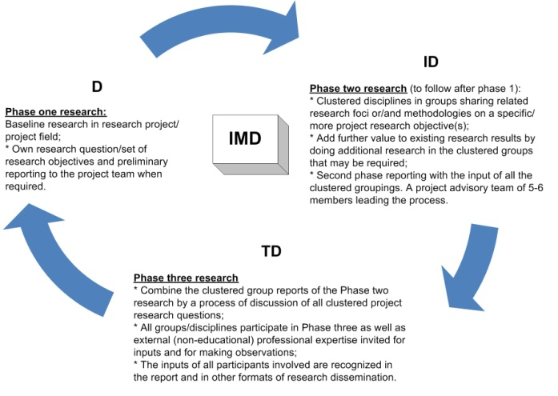
A suggested research approach to Integrative Multidisciplinary (IMD) research for progressing from the Disciplinary (D) to the Interdisciplinary (ID) and the Transdisciplinary (TD) phases
Exploration Phase
2011
Brainstorming;
Visiting the broader municipal area;
Structuring & restructuring & …restructuring!;
Ecohealth Forum;
Personal research

Slide 6
UNDERSTANDING INTEGRATIVE MULTIDISCIPLINARY (IMD) RESEARCH
√ IMD is an intensive disciplinary cooperation process that runs on an equal input basis between researchers from the start of a joint research project. It should progress from a constructive Disciplinary phase point of departure for cooperation and discussions and gradually transforms into an Interdisciplinary phase of collaboration;
√ In the ID phase research skills and knowledge integrate into combined/integrated research questions, outcomes and activities according to a research protocol that fits the team, but research participation and progress [in D and/or in ID clusters] always with the input, consent and approval of the full IMD team;
√ The final IMD process progresses to a TD phase which is inclusive of/encapsulates: i) Intensive community Indigenous Knowledge System involvement/considerations; ii) Community Management/ Leadership involvement within municipal circles; iii) Expert involvement broader than the IMD-research team boundaries iv) Proactive recommendations and solutions towards aspects of the community status, by also uplifting/supporting/providing the community with certain skills and involving them in research processes and keeping involved in a post research report phase (Community building phase/Sustainability support phase).
The latter process can also be visible from an ID-phase.
This particular research model is in progress as it is currently tested in the research field, and may still requires refinement.

Slide 7

NRF-PROJECT FOCUS IN COMMUNITY ENGAGEMENT: Exploring integrative multidisciplinary-focussed research on the health and well-being status of mining communities: The case of Bekkersdal, Westonaria
Primary Research Question:
To explore the possibility of doing integrative research on the health and well-being status of mining communities;
Secondary research questions by approx. 10 disciplines (22 researchers in clusters or/and separate) to accomplish the project theme, departing from the disciplinary known, growing gradually into the dispersed and more challenging but accomplishing/rewarding world of combined/interdisciplinary perspectives on the primary research topic. By also developing secondary research questions related to ecohealth and wellbeing research, all disciplines "feed" the core research focus.
A disciplinary combined Baseline questionnaire also was developed in 2013 to capture some general features of the ecohealth and wellbeing of the Bekkersdal community that could guide /direct the clusters of disciplines towards working more in depth on certain aspects of the research as identified.
Bekkersdal- Project: Broad (eco)health and wellbeing reflection required by the team.
Notes:
<number>

Slide 8
ECOHEALTH AS THEME IN INTEGRATIVE MULTISDICIPLINARY (IMD) RESEARCH
NRF-Research on the mining community Bekkersdal (2013-2015)
BROAD ECOHEALTH & WELLBEING FOCUS:
To determine the ecohealth & wellbeing status of people in Bekkersdal in:
- their built environment (eg. services, housing, service delivery, local management, security, etc.);
- their immediate/natural environment (eg. environmental capacity, issues and concerns);
- their well-being environment (eg. financial, physical, social, emotional; psychological etc).

Slide 9
Research objectives in regional history as participating in IMD-research
As focussed tasks in this context of space (Bekkersdal) and time (1945-2013) and with ecohealth and wellbeing as broad theme my task are to:
record and historically analyse information and published research that should reveal the health history or/and well-being status of the Bekkersdal community/area before and since 1945;
record oral and written information (the latter in popular and scientific writing) on the responses/impressions of the Bekkersdal community members regarding a coping with their status of living and their experience of the natural environment. [VERY LIMITED STUDIES SO FAR DONE ON THIS AREA: WHICH HAS MADE IT FEASIBLE FOR THE IMD-TEAM TO ENTER AFRESH]

Slide 10
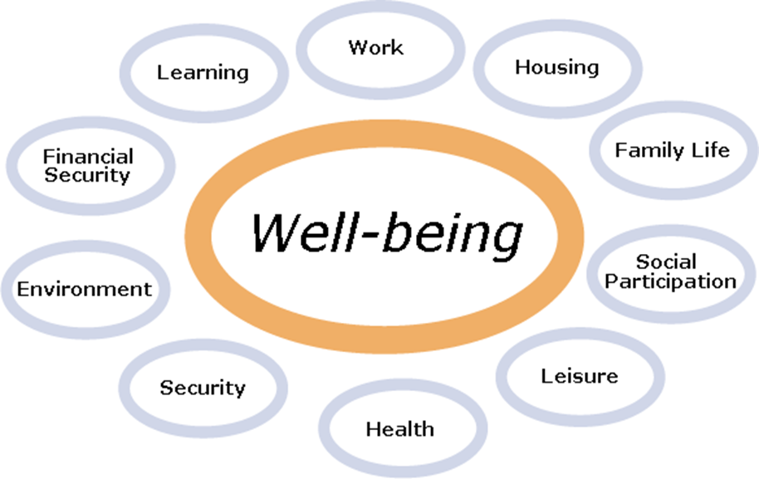
Current areas of research in the NRF-Community Engagement Study on ecohealth and wellbeing in mining communities: BEKKERSDAL as case study
Historical Legacy
Service delivery & Local management
Regional (History) Studies
In Ecohealth &
Constitu tional rights
Political Legacy

Slide 11
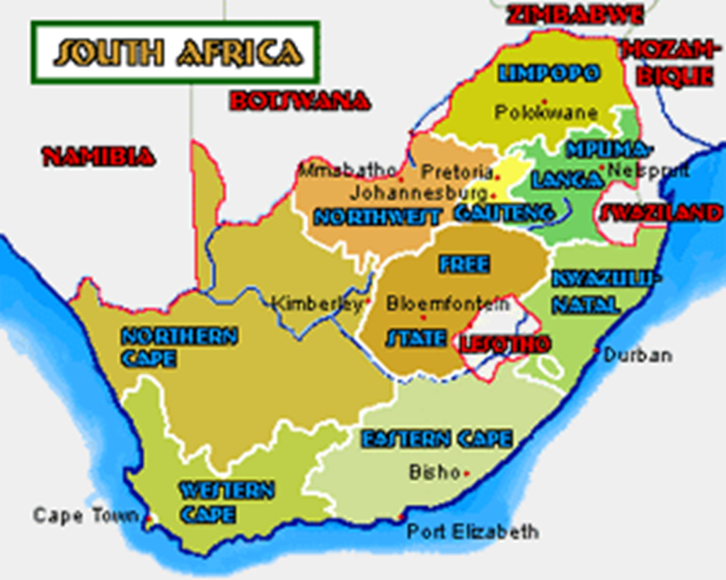
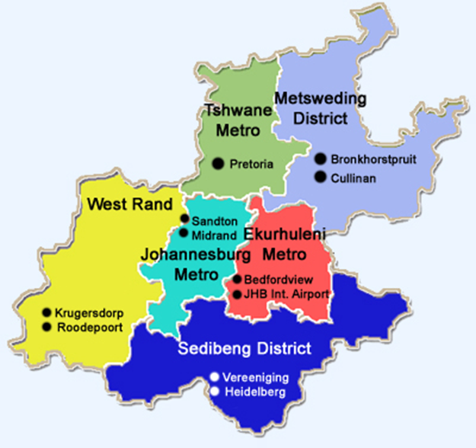
SPATIAL ORIENTATION, STUDY AREA
GAUTENG province
GAUTENG PROVINCE
A current IMD research project in Bekkersdal: as community in a "post-mining" context and a typical vulnerable place
Westonaria, Bekkersdal

Slide 12
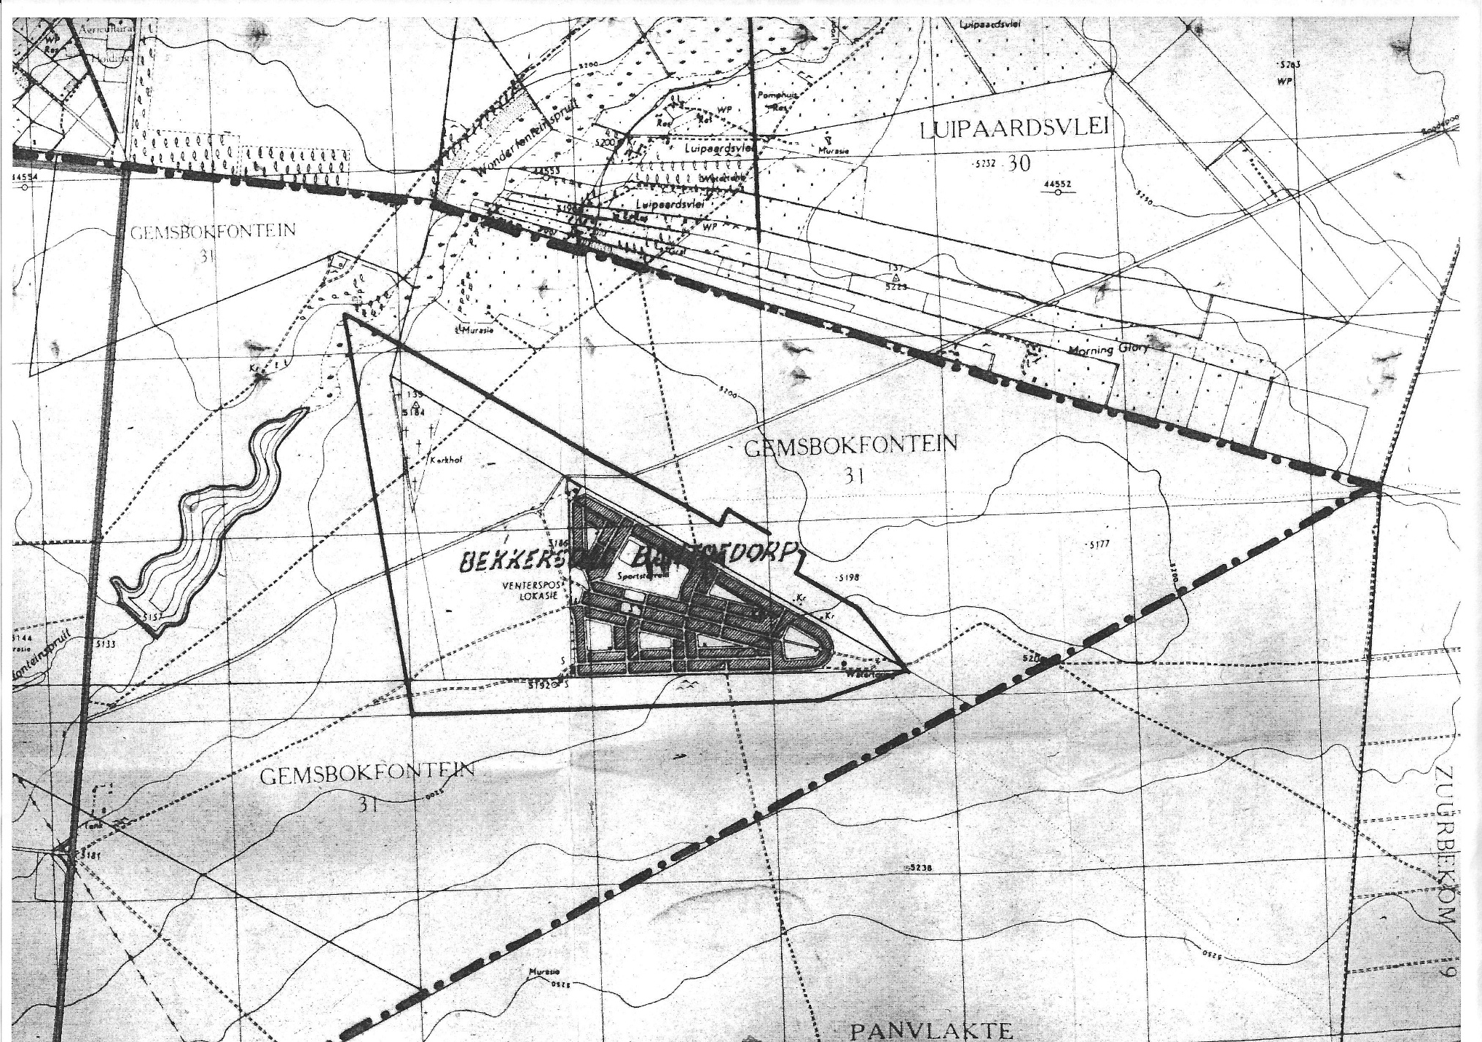
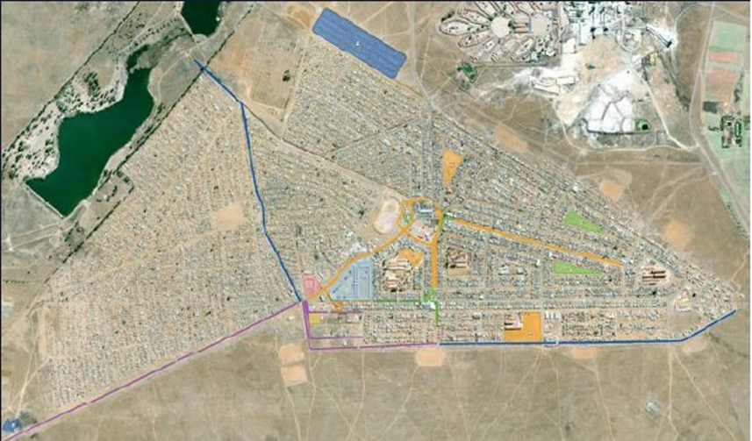

Bekkersdal a concise spatial settlement history
By the early eighties Bekkersdal colloquially referred to as Squatterville.
Backyard shack developments in the formal side then at the order of the day. Municipality try to demolish as soon as they appear at request of Government.
By 1989 other shack areas surrounded the whole of formal Bekkersdal township, like Silver City, Spooktown (Ghost Town) and Skierlik (to be translated as “Suddenly”) and Tlhatlhaganing etc. In most cases the informal land occupation was not on property of the local Town Council of Westonaria.
To serve the gap in housing in house shortages for black people after 1945, several squatter camps developed on illegally occupied vacant ground near towns or places of work. Government allowed this temporary arrangement as it was hardly possible to eject squatters. Service delivery became a menace for squatters and local governments close-by .
In 2011 informal settlements in WLM accounted for 75% (62 911) of the population and 25% (40 142) of the population was in formal housing :
111 767 inhabitants in total.
SA-Government 1942: Avoid... founding more black spots as what is absolutely necessary
Registrar of Title Deeds, cnr Pretorius & Bosman Streets, Pretoria, Title Deed Gemsbokfontein IQ 290. See also TT(See Map D/T 21822/49; Diagram 1527/45; Title Deed 21822.

Slide 13
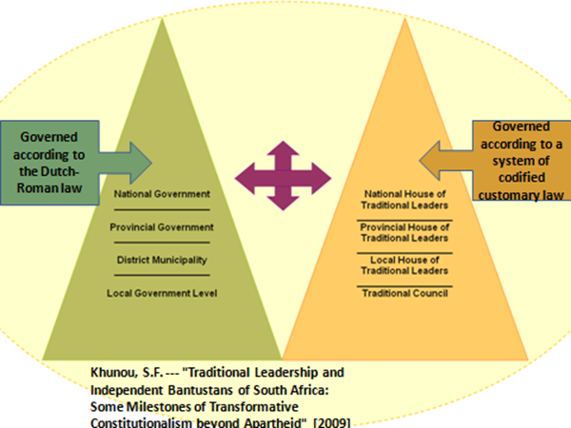

The broader context of what was happening in Bekkersdal is/was
embedded in the BRITISH COLONIAL MODEL OF INDIRECT RULE in SA
Economy, political and social thoughts/doings
dominated by the one in power. The oppressed
divert to several forms of nationalism to obtain/express power/freedom
E
C
O
N
O
M
Y
Separate "governing bodies" based on race/groups/class
The trend appears to be that the indigenous
Afrikaner sentiment NP government followed the Indirect Rule systems of modernization, and so the
ANC-government after 1994

Slide 14
Bekkersdal Regional history features: | Its Colonial and Apartheid relatedness
British colonial activity allowed for British and other foreign companies to invest in gold mining in South Africa. | System of Indirect Rule governance distorted local governance practises because of different governing and legal systems applying to different groups of people.
Hectares of land was obtained by foreign investors. For Bekkersdal land was made available in 1945 by Western Areas Limited and Randfontein Estates Gold Mine. Further expansion and developments were difficult in Apartheid times and still afterwards. | Land occupation in Bekkersdal, within the spirit of thinking of the time, regarded as temporary. Future town planning and development therefore was limited to the bare basics within a limited local gov. budget.
By virtue of Act 25 of 1945 the colonial mentality of the time was exposed of “allowing” limited to controlled land occupation by black people, especially close to industrial development in so-called “white” demarcated areas. Apartheid government after 1948 continued this colonial mentality. | Primary family ties distorted due to a mining environment in the colonial and apartheid past complimenting male workers: By 2013: 61.153 males and 50 616 females. Inferiority, acculturation, frustration, educational backlog, moral disintegration and a helpless hopelessness developed among especially informal inhabitants.
Notes:
<number>

Slide 15
New housing initiatives in the Westonaria Borwa Housing Development and Mohlakeng Extention 11 as well as the Thusanang housing development were to reduce the housing shortage, as it was done before 1994 elsewhere in Bekkersdal…the pace however to slow for the growing number of residents;
Though the educational levels of the community in general has improved since early times, Westonaria’s Grade 12 performance in 2011 turned out to be the lowest in the West Rand Local Municipality in which it functions (namely a 20.6% completion of Grade 12)
The new 1994 democratic government improved the service delivery divide, and invested, with the assistance of foreign donors and the public sector, billions of Rand into the area – Flagship programmes & BURP. Some residents by 1998 received title deeds for their property;
An apparent lack in moral obligation to pay for services rendered (water, electricity, levies and property rates) among community probably also lead to the outsourcing of services…countrywide; The WLM (Bekkersdal the largest community) in 2013-2014 was R124.8 million in arrears;
Poverty, tribal conflicts, the racial history, class divide and a still visible colonial attitude as well as mentality of being clustered in an Indirect Rule mode, prevailed: among leaders, way of governance and within community.
HISTORY BEKKERSDAL

Slide 16
Profile of the broader Westonaria in which Bekkersdal is situated:
- Municipal Area: 545km2 (quite central to other development)
- Total property stands//erven: 10 379
- Farm portions: 507
- Agricultural holdings; 904
- Industrial Stands: 63 (of which 30 were developed and 43 vacant, which at the time still left room for business development). ECONOMIC STATUS IN MINING remains distorted
- Schools: Three high schools; Nine primary schools
LOCAL GOVERNANCE & ECONOMIC PLANNING HISTORY BEKKERSDAL

Slide 17



A R2.1 billion presidential project mainly managed
from provincial level, locals not experiencing sufficient participatory involvement.
BURP-"For future years to come"

Slide 18
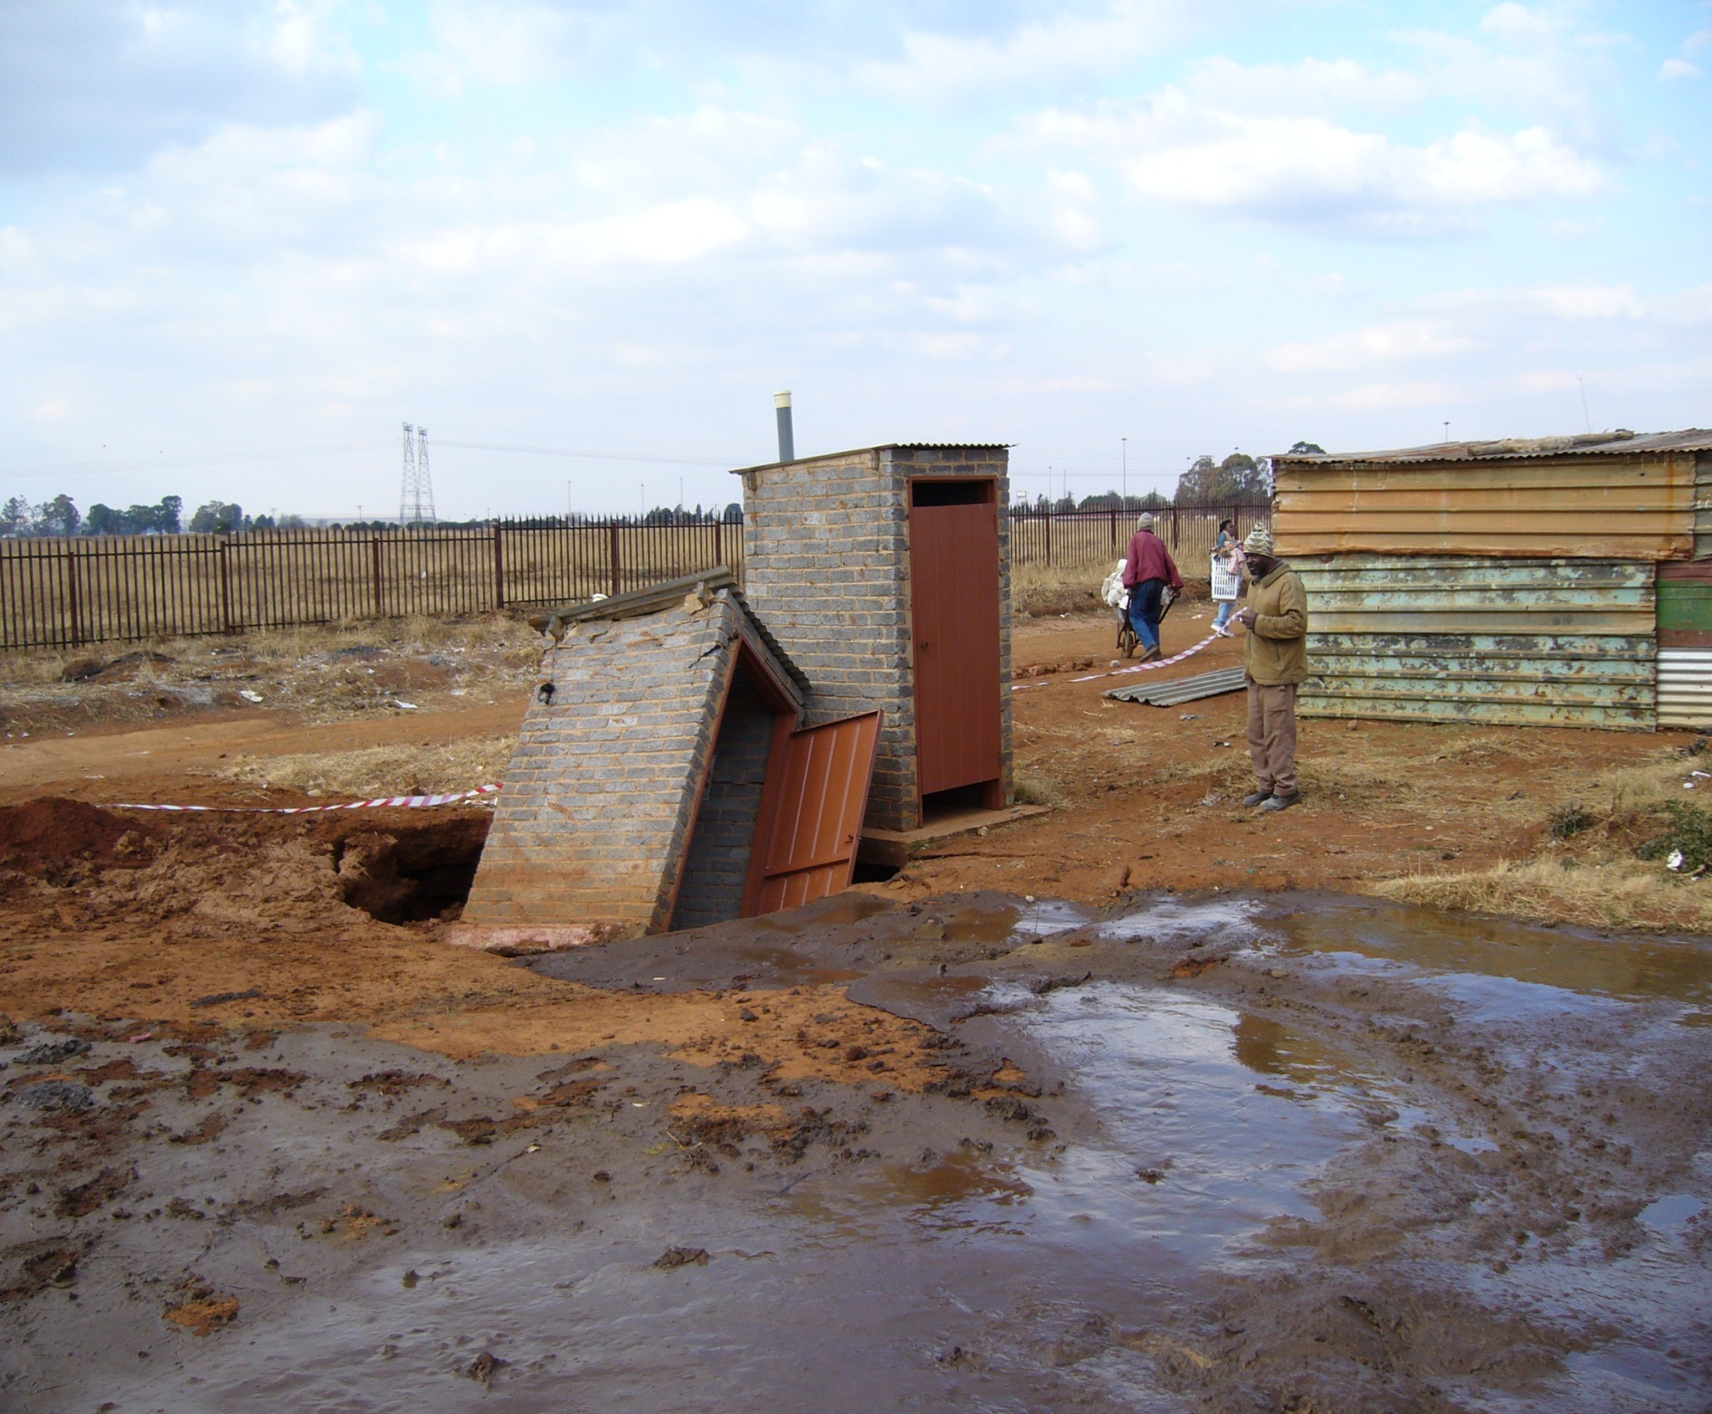
BURP- delivery difficulties in 2006-2007 in the Transit Camp, north of
Spooktown due to dolomite instability and sinkhole exposures

Slide 19
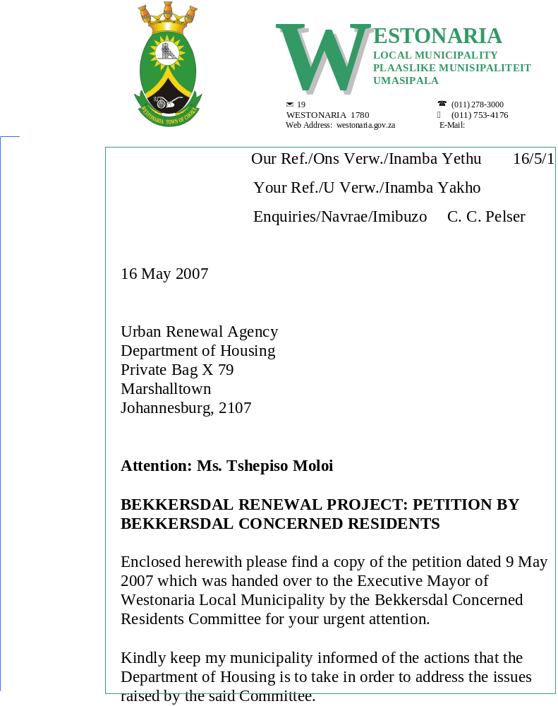

Slide 20
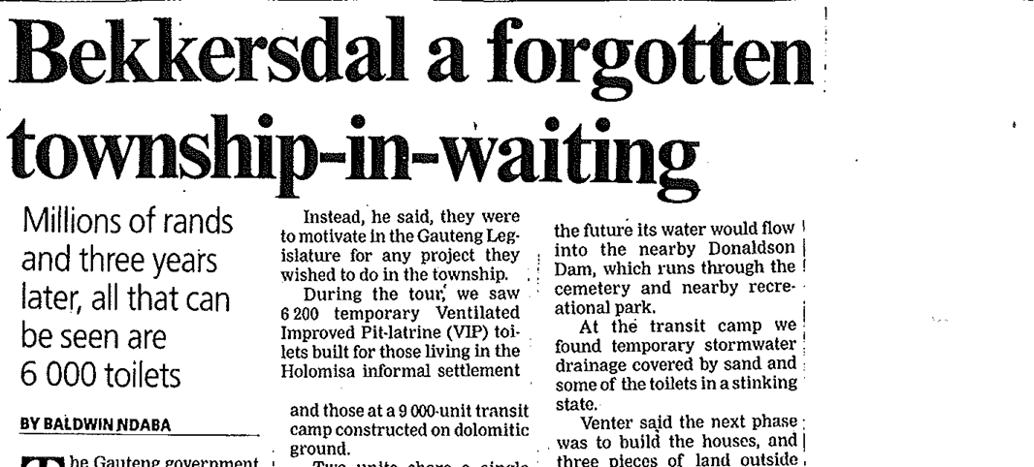

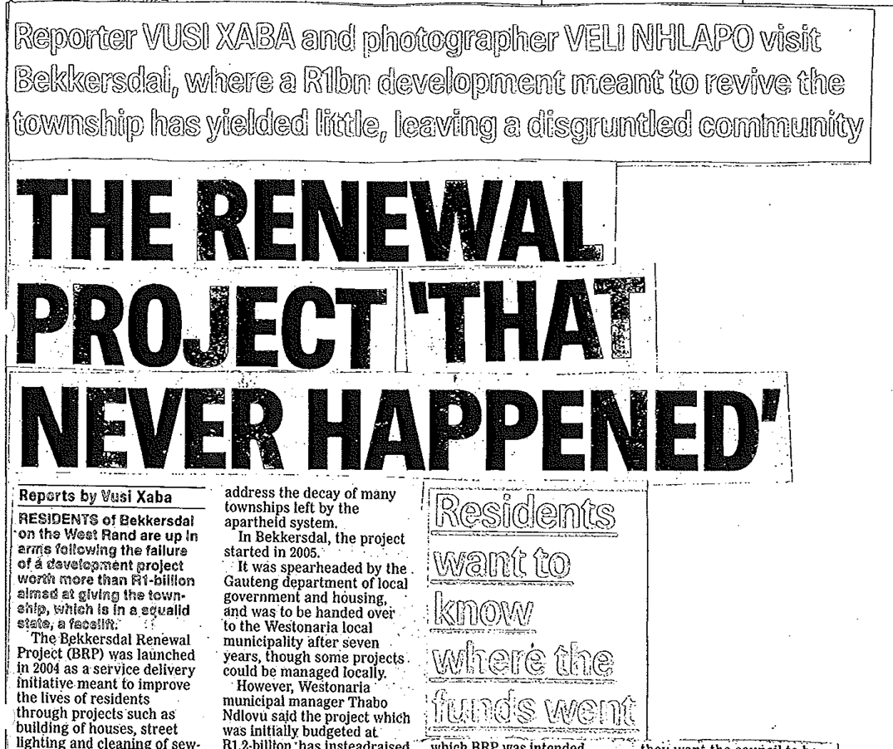

City Press, 11 November 2007, p. 1.

Slide 21
A typical letter from the Municipality to the Department during the BURP second five year phase (5 February 2010), after crises with a heavily overflowing sewer manholes in Bekkersdal informal:
…The Municipality has undertaken countless unfunded mandates, thanks to the poor workmanship on the BRP [BURP]. It was noted that we’re experiencing serious financial challenges, but the Department still expect us to assist. The community is up and arms and expects us (the Municipality) to account on appalling conditions they’re expected to endure on a daily basis due to the unfinished work left behind by contractors. How do we account on a project that is run by the Province? The irony of this matter is that we’re a government closest to the community and they see government as one government to them, the councillors should account to them on all developments within their constituencies. We strongly recommend that, the department and its professional team hand over, the project in our capable hands…

Slide 22
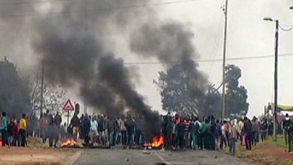
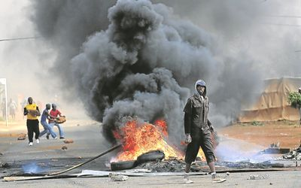
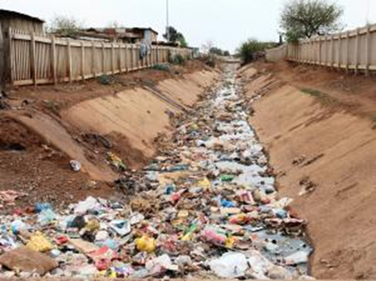
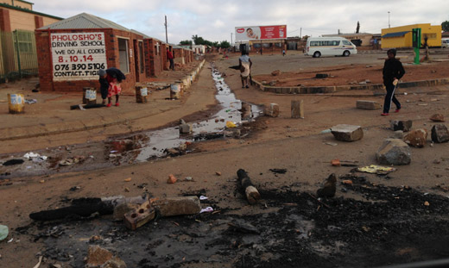
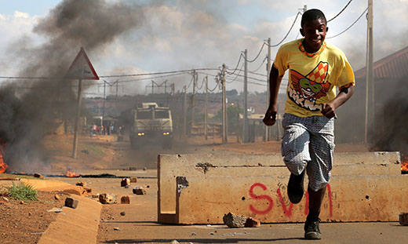
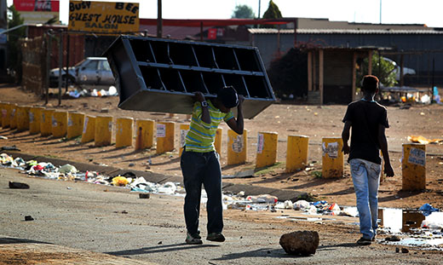
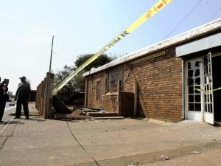

SERVICE DELIVERY DESTRUCTIONS AND VANDALSINNG IN BEKKERSDAL, 2013
bdlive.co.za
Waste disposal of the open canal around the informal settlement
sabc.co.za
ewn.co.za
Iol.co.za
Community Care Centre torched
24 Oct 2013 report

Slide 23
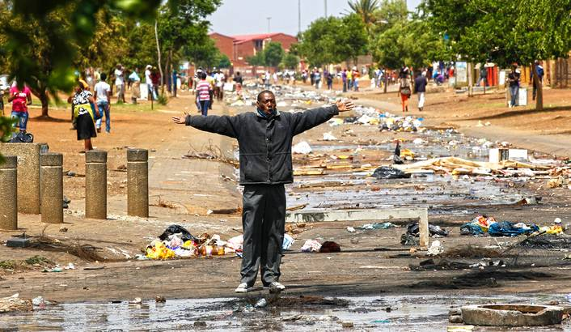
Richard Poplak, “ Hannibal elector: How Bekkersdal became a symbol of everything that’s wrong with South Africa”, Daily Maverick, 18 March 2014

Slide 24
POLITICAL BEKKERSDAL: ITS ECOHEALTH & WELLBEING RELATEDNESS

Slide 25
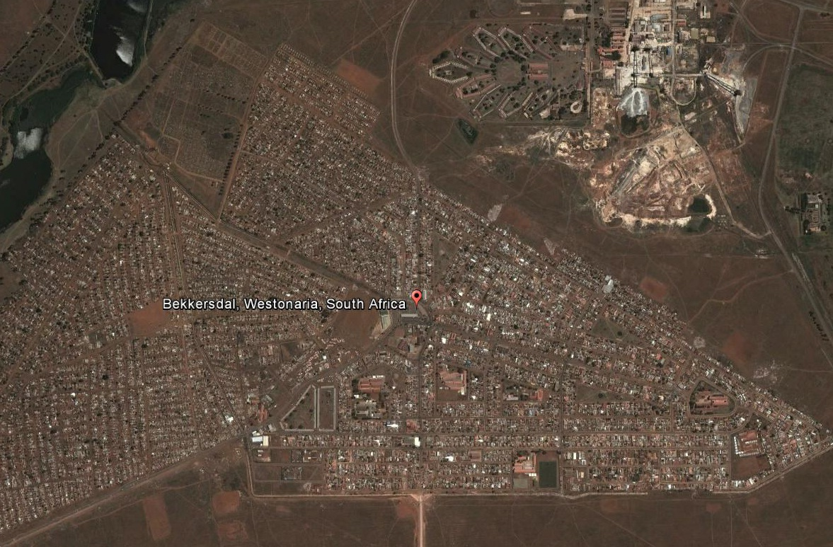
Bekkersdal in the 21st Century
INFORMAL SIDE
X-Section
IFP
Cook Shaft…later
Rand Uranium: will
soon be Gold 1
Z-section
(informal)
"UPTOWN" BEKKERSDAL
FORMAL SIDE
“Uptown” Bekkersdal, an area historically known to be “Black Consciousness” territory (especially the Azanian People’s organisation and the Pan Africanist Congress).

Slide 26
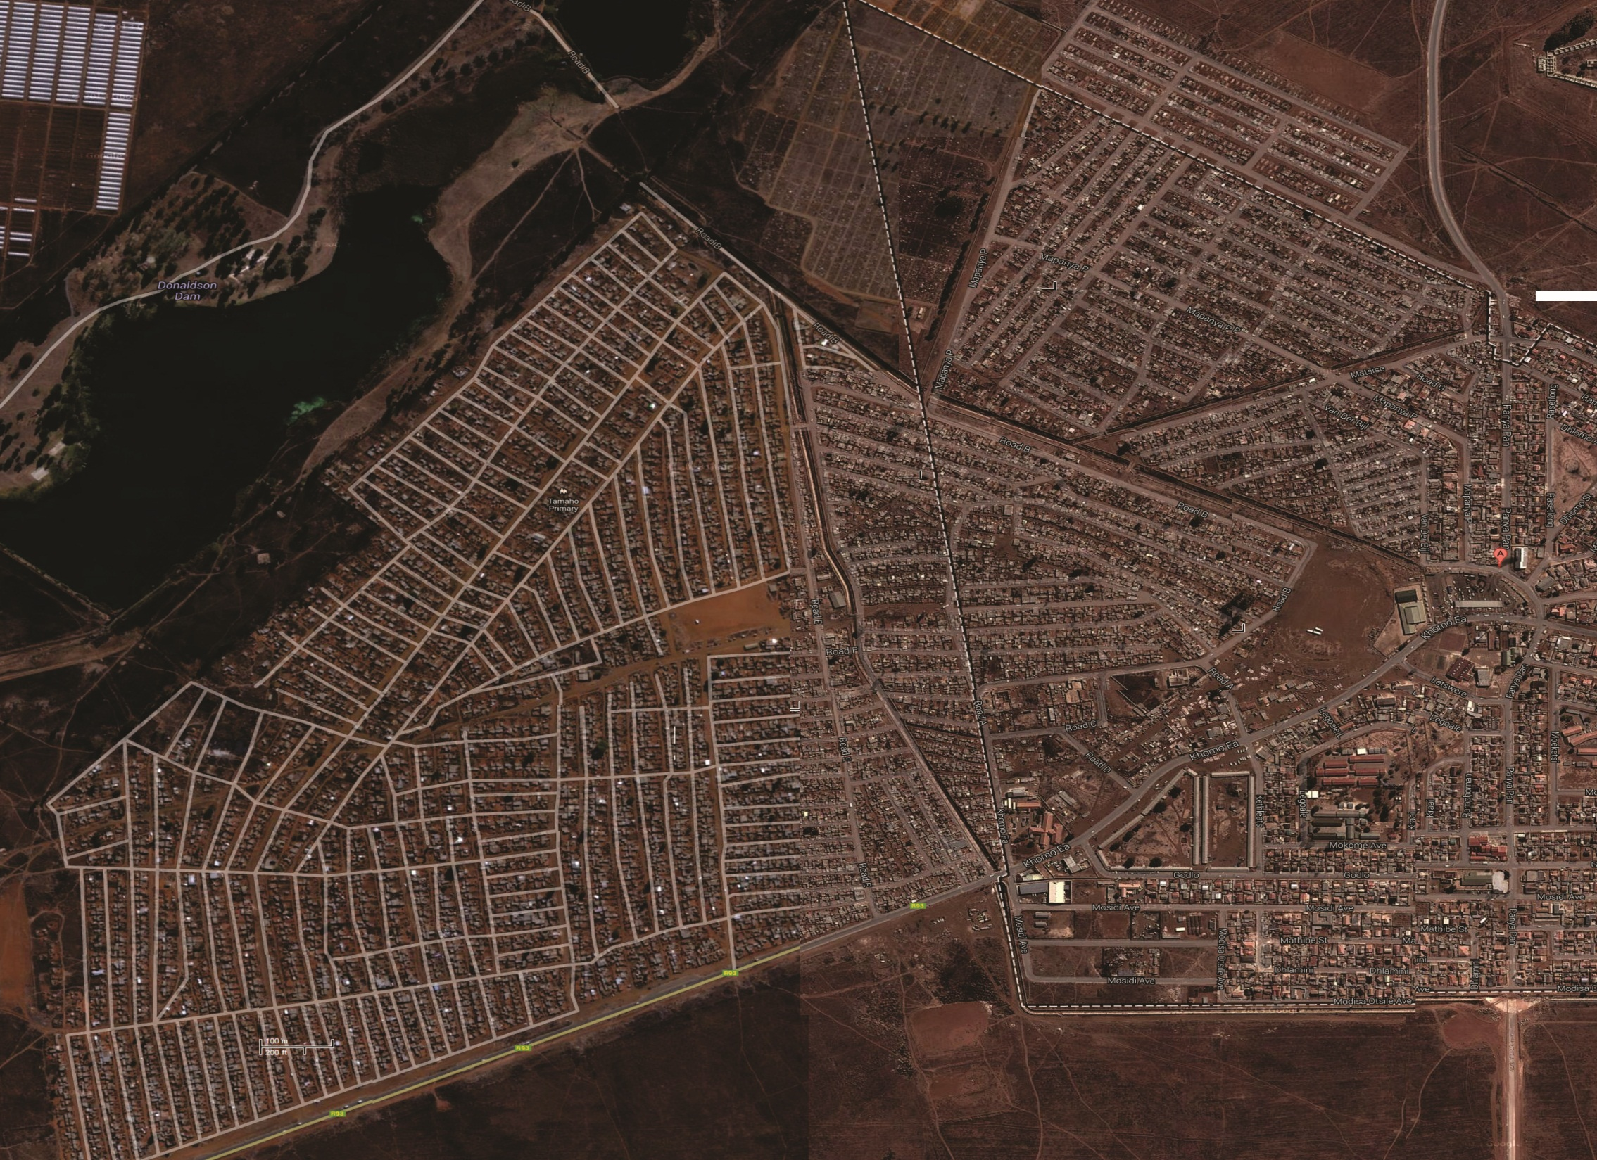


N
Access
tar road
Transfer camp (1993)
Some residents recently removed to Mohlakeng x11, Randfontein
COOK
MINE
Cement
canal
Graveyard
SKIERLIK
X-Secti
on (IFP)
1993)
SPOOK
TOWN
Ca 1984
DONALDSON DAM
in Wonderfontein Spruit
WINNIE/
HOLOMISA
Ca 1993
SILVER
CITY
NON-FORMALISED PART OF
BEKKERSDAL
Cement
canal
W
Possible Park by WLM
MANDELAVILLE
1990
Taxi
rank
E
Local Business Support centre
WINNIE/
HOLOMISA
Ca 1993
West
Clinic
Hostel
(1964)
TAMBO
1993
Z-Section
[Ghana, 1997]
TAMBO
Ca 1993
Industrial Area
FORMALISED PART OF
BEKKERSDAL
WINNIE/HOLOMISA
Cement
canal
Small Recycling Depot
Access
tar road
Library
S
Filling Station
East Clinic
Primary Schools
Notes:
<number>

Slide 27
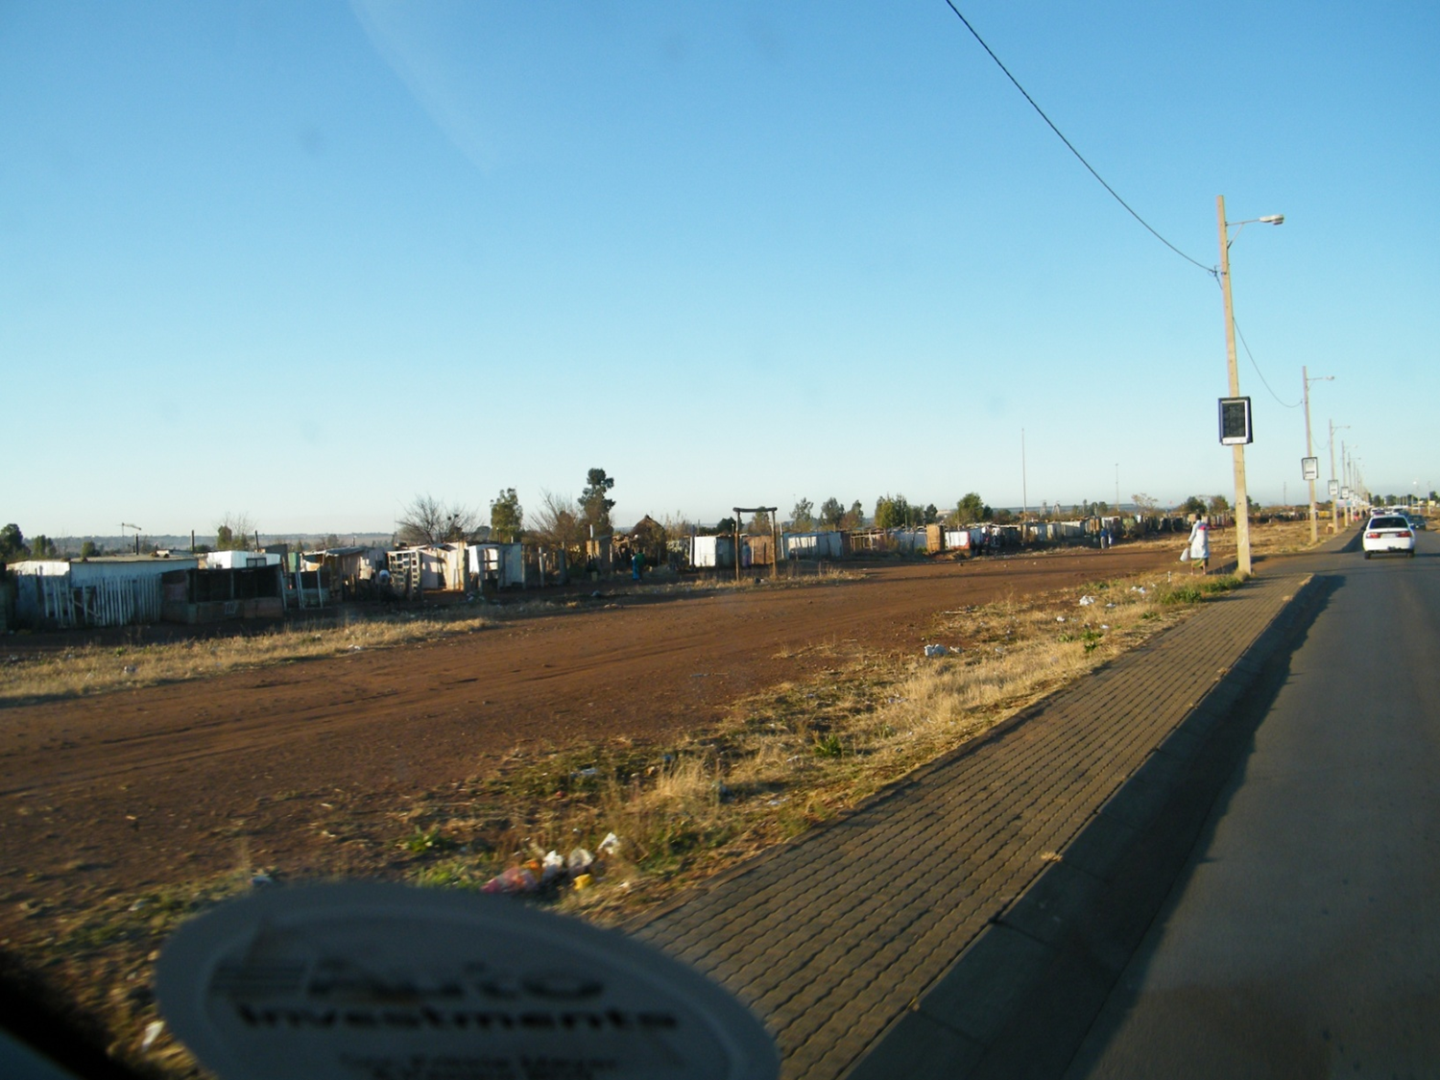
THE IMD RESEARCH PROJECT in the meantime STARTS, January 2013

Slide 28
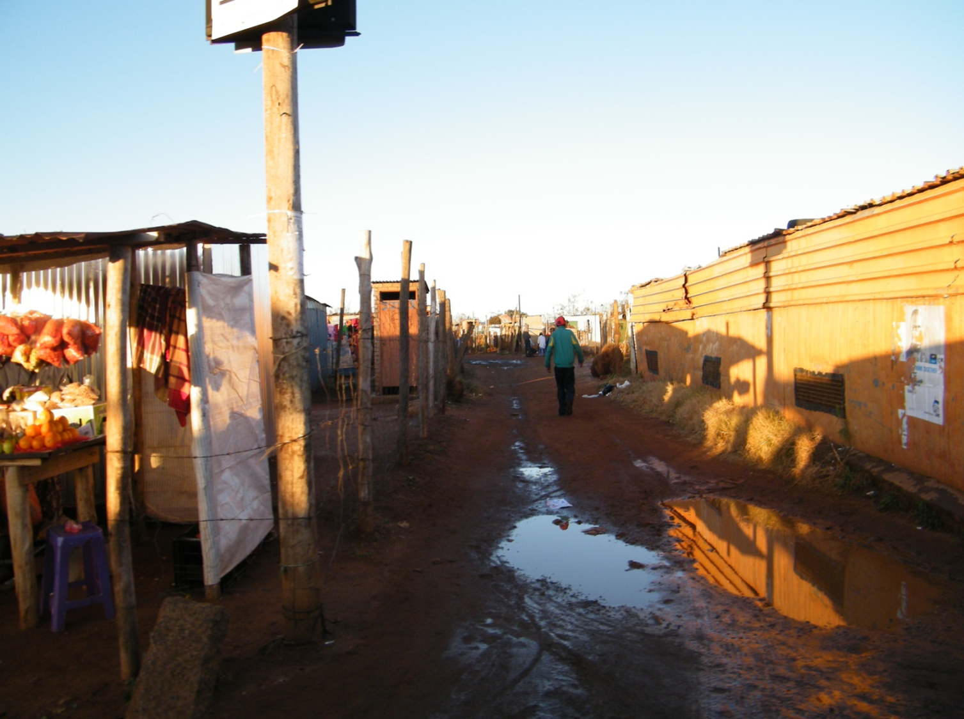

Slide 29
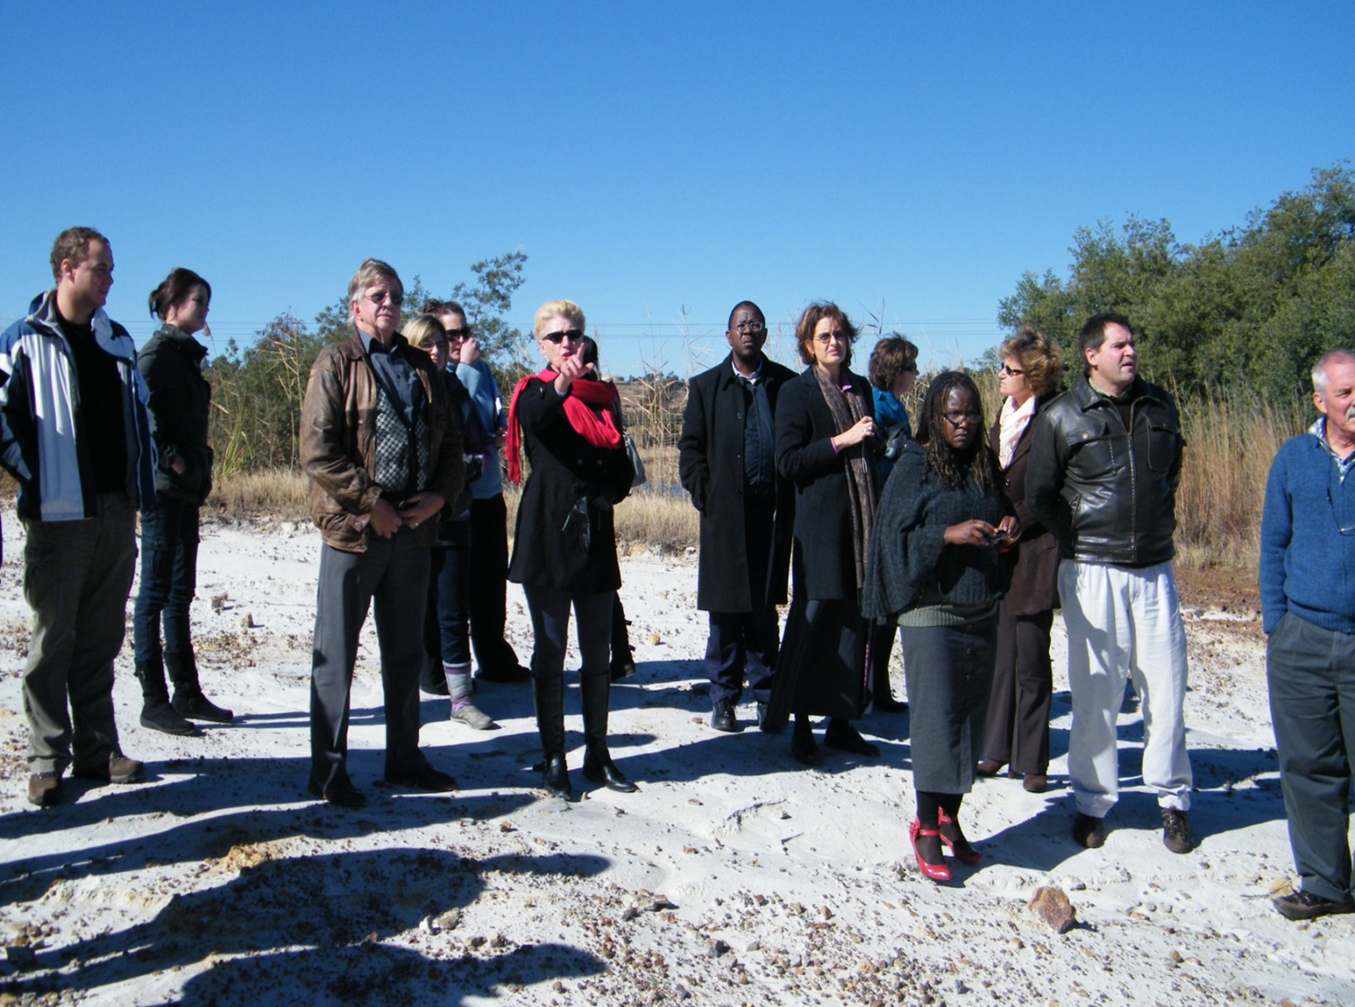

Slide 30
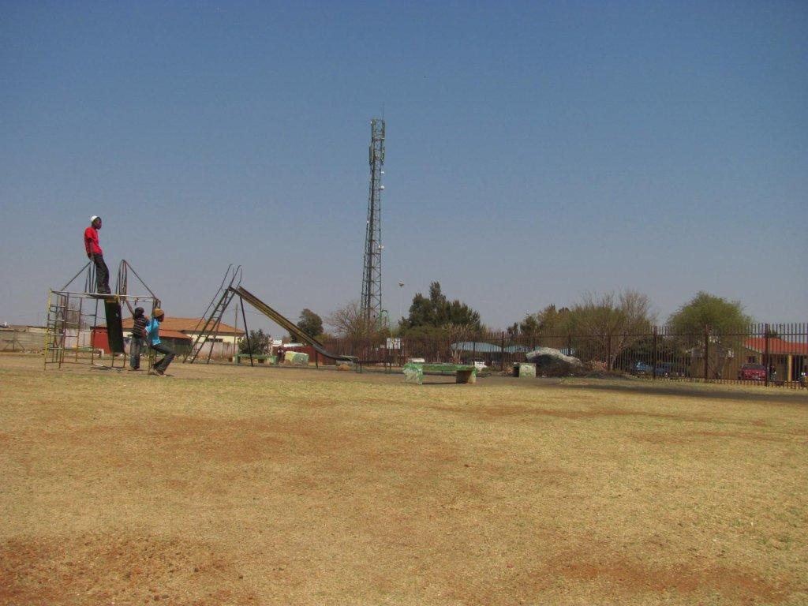

Slide 31
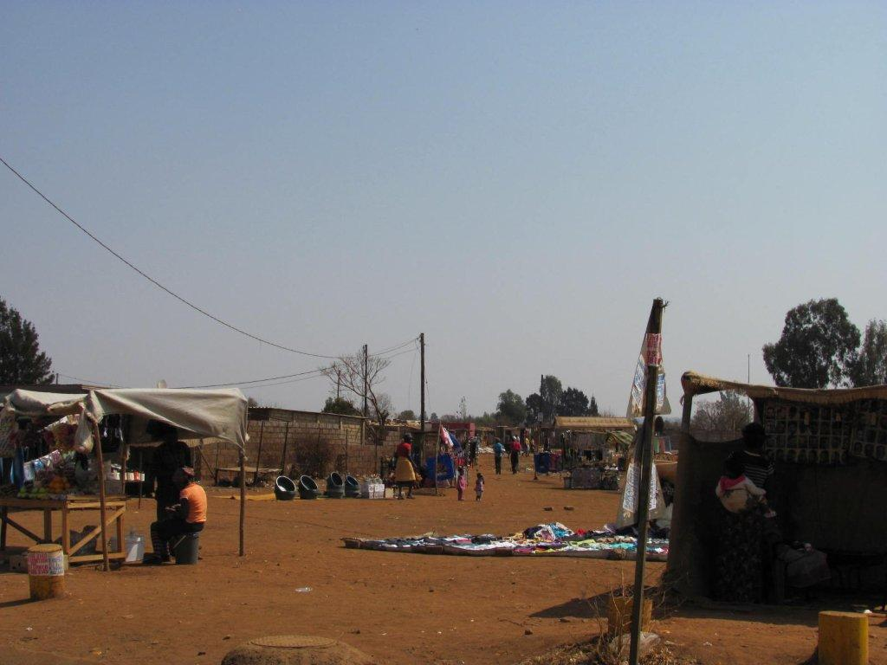
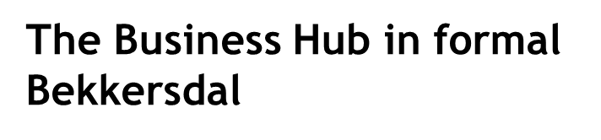

Slide 32
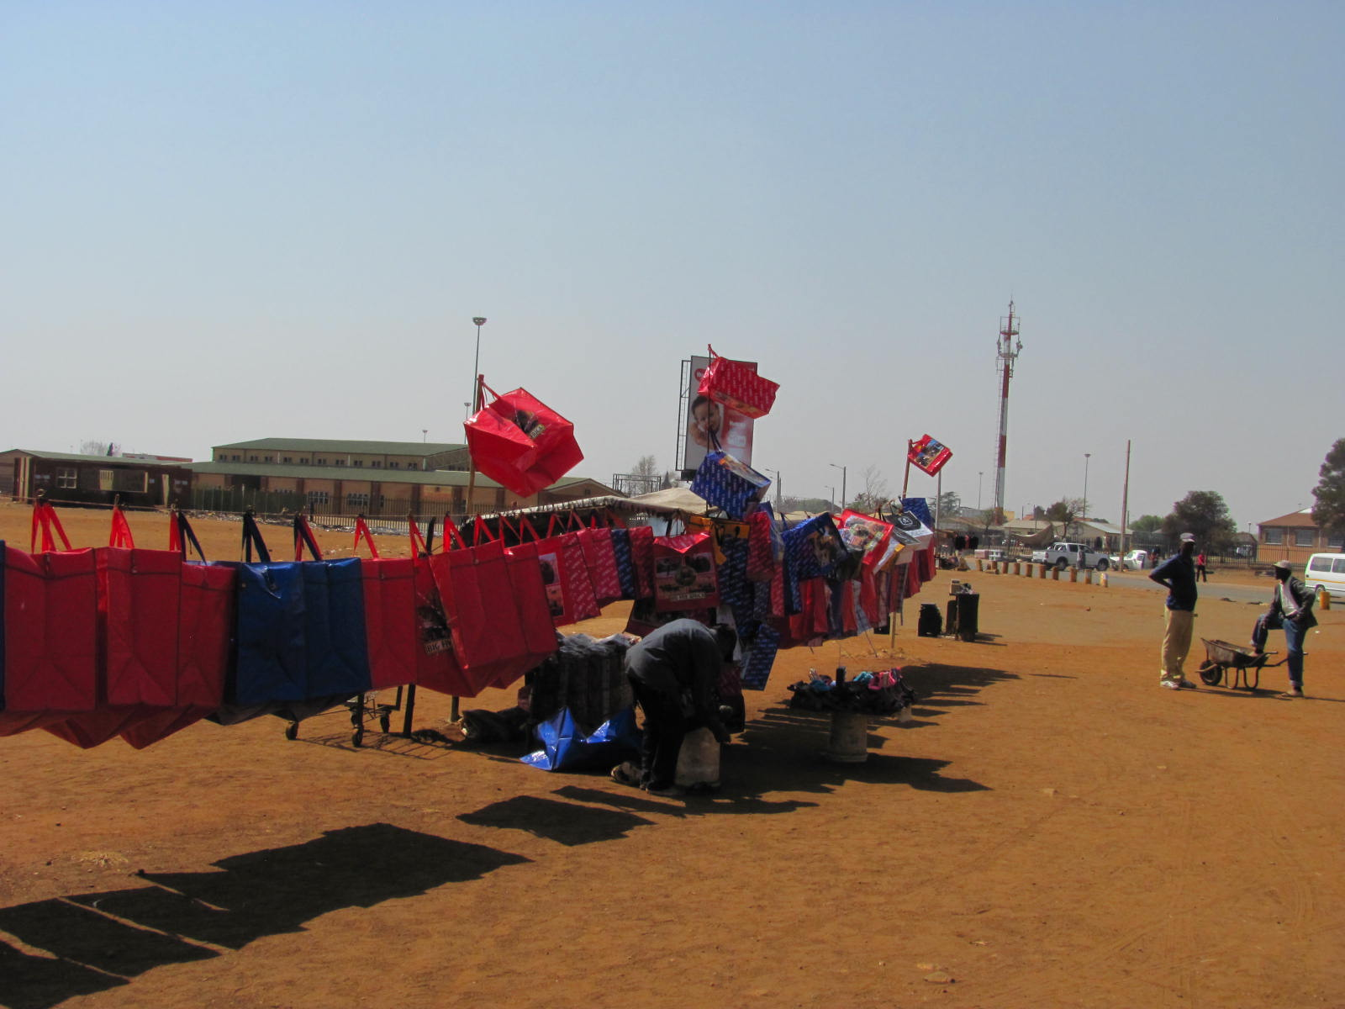

Slide 33
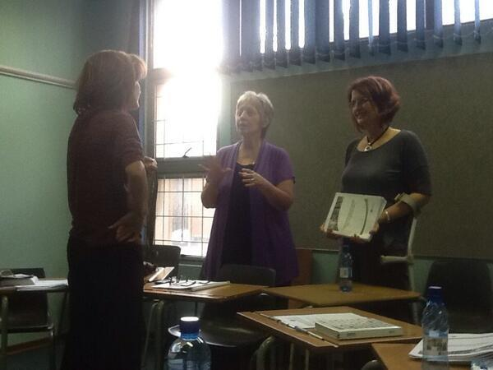
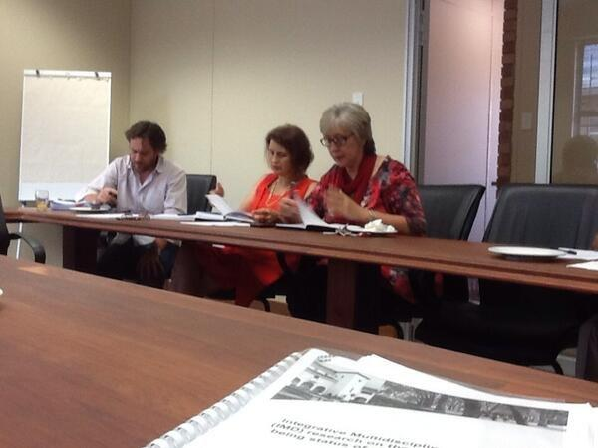
Some findings of the IMD baseline questionnaire fieldwork in 2013 on the Ecohealth and Wellbeing status of Informal Bekkersdal: sample 520; 14 sections; 61 questions – duration to complete: 90 min.
The value of being informed on the land and the service delivery history of Bekkersdal to progress towards doing IMD research on for example the area’s ecohealth and wellbeing status

Slide 34
FINDINGS - GROUPS
Social groups/networks
Participation in social groups
Participation, and associated cohesion, seemingly very low
SOCIAL GROUPS | YES | NO
Volunteer at an organisation like NGO/FBO/CBO | 8% | 91.8%
Community-based co-operative | 7.6% | 92%
Self-help group | 14.7% | 84.9%
Social club | 5% | 94.8%
Women’s group | 13.%1 | 86.9%
Youth group | 10.7% | 89.3%
Elderly group | 6.2% | 93.8%
Sports club | 9.7% | 89.7%
Religious group | 37.2% | 62.8%
Community policing forum | 6% | 93.4%
School governing body | 4.6% | 95.2%
Ward committee | 8.5% | 91.3%
Street committee | 10.1% | 89.5%
Local Anti-drug Committee | 5.4% | 94%
Prof Freek Cronjé & team-Benchmarks-Sociology
Notes:
<number>

Slide 35
FINDINGS - INSTITUTIONS
Family
Happiness of your family
Happy | 41.6%
Unhappy | 57.5%

Slide 36
FINDINGS - INSTITUTIONS
Family
What contributes to your family’s happiness?
To have work (n=79 – 15.7%)
To be with family (n=56 – 11.1%)
To have a house (n=55 – 10.9%)
Sticking together (n=47 – 9.3%)
Having money (n=30 - 6%)
What hinders your family’s happiness?
Being unemployed (n=107 – 21.3%)
Crime (n=69 – 13.7%)
Corruption (n=63 – 12.5%)
Not having a house (n=46 – 9.1%)
Not having electricity (n=38 – 7.6%) Being Educated?

Slide 37
FINDINGS - NORMATIVE BEHAVIOUR
Support (receive and/or give)
Support received, given and/or contribute to
Receive rather than give…
Outside agents give support…'Poverty trap' mode…
 | RECEIVE | GIVE/CONTRIBUTE | NOT APPLICABLE
Moral/spiritual guidance | 59.4% | 10.3% | 29.4%
Health support | 75.1% | 5.6% | 19.1%
Home-based care | 49.5% | 9.1% | 41.2%
General social support | 41.4% | 15.1% | 42.5%
Marriage counselling | 7.4% | 7.8% | 84.9%
Support on burial matters | 32.6% | 17.9% | 46.9%
Moral support for children | 31.6% | 29.6% | 38.2%
Share information | 38.6% | 28.6% | 30.6%
Financial support | 38% | 12.7% | 48.3%
Crime prevention | 37.2% | 13.7% | 48.7%
Access to goods and services | 23.1% | 11.7% | 64.6%
Practical help | 29.4% | 23.1% | 47.3%
Political education/guidance | 36.2% | 12.1% | 50.1%

Slide 38
FINDINGS - CULTURE
Hobbies/Recreational Activities
Participation in hobbies and recreational activities
Participation generally low
Correlates positively with social interaction and cohesion
HOBBIES/RECREATIONAL ACTIVITIES | YES | NO
Playing soccer | 29.4% | 70.2%
Fishing | 4.6% | 94.8%
Dress making/tailoring | 8% | 91.8%
Fixing cars | 3% | 96.8%
Cycling | 8.9% | 91.1%
Plaiting hair | 11.5% | 88.3%
Gardening | 33.6% | 66.4%
Writing songs | 4.8% | 95%
Singing/Choirs | 14.9% | 84.9%
Gambling | 6.6% | 92.8%
Traditional dancing | 11.3% | 88.3%
Writing poems | 3% | 96.6%
Art work | 8% | 91.1%
Cooking/Baking | 55.%7 | 43.5%
Watching sport (TV) | 41% | 57.9%
Watching sport (Live) | 28.6% | 70.2%

Slide 39
FINDINGS - FUNCTIONALITY
Functionality of local Government
The local municipality as service provider:
Poor service (n=179 – 35.5%)
Bad (n=51 – 10.1%)
Nepotism (n=45 – 8.9%)
Don't keep promises (n=30 – 6%)
Failing us (n=27 – 5.4%)
Awareness of the local municipality and assistance:
Yes, but they don't do anything (n=142 – 28.2%)
Yes, but they are corrupt (n=36 – 7.2%)
Yes (n=28 – 5.6%)
Yes they have assisted (n=24 – 4.8%)
Yes, but there is nepotism (n=23 – 4.6%)

Slide 40
Effect of environmental problems/risks (n=501)
Problem/Risk | Very bad | Not so bad | No problem
Dusty | 90.8% | 7.4% | 1.8%
Dangerous fumes | 49.8% | 27.6% | 22.6%
Underground mining | 41.5% | 34.3% | 24.2%
Dolomite underlain area | 38.0% | 31.9% | 30.1%
Sinkholes | 41.2% | 32.7% | 26.1%
Acid underground water | 21.5% | 28.3% | 50.2%
Donaldson dam | 43.8% | 20.8% | 35.4%
Litter polluting area | 87.1% | 9.4% | 3.4%
Area is noisy | 88.6% | 10.6% | 0.8%
Polluted soil | 62.8% | 27.4% | 9.8%
Access to clean drinking water | 25.5% | 29.7% | 44.9%
Open canal | 35.9% | 30.1% | 33.9%
Lack of recreational facilities | 63.7% | 22.8% | 13.6%
Visible sewerage overflow in streets | 74.1% | 13.8% | 12.1%
Community's impressions
on some environmental risks, as historically perceived , different
Dr E de Crom, Environmental conservation

Slide 41

Growing towards a
democracy
C
O
L
O
N
I
A
L
L
EGAC
I
E
S
3
6
2
Y
E
A
R
S
Racial//Class
Economic
Social
Cultural
Religion
Way of governance
Way of governance
Leadership
Way of living
ROOTED way of…things…impacting on groups/individual world/life view
Notes:
<number>

Slide 42
Example of a distorted view/impression of why life is as it is in
Bekkersdal informal settlement in 2013
...There is no location is bad like Bekkersdal here in Gauteng. And Bekkersdal is and old location. But nothing has changed, They just promised us a better life, but there is no better life at all. Instead there is an apartheid against Black people. What I see here is a disaster I don’t know how to explain. Only God know [sic]...
Fieldworker Noluthando Ngukiza, Dec 2013.

Slide 43
[Richard Poplak -journalist] asked him [a Patrick] if Bekkersdal’s residents have a solution for Bekkersdal: The situation here has become a performance for which no awards will be given. The anger destroys the town, the destruction is photographed, the photographs define the country, and the politicians vow to fix the rot.
[Poplak continues]: But what we all seem to be missing is that Bekkersdal represents a complete meltdown that reaches back into centuries of exploitation, and to “fix” it means fixing ourselves, remodelling not only our political culture, but our role as citizens in this country
Richard Poplak, “ Hannibal elector: How Bekkersdal became a symbol of everything that’s wrong with South Africa”, Daily Maverick, 18 March 2014.

Slide 44
Conclusion for now
The Bekkersdal region's development, within the country's colonial history of management according to an Indirect Rule sysyem, should not be ignored in favour of racist apartheid only. Especially when trying to understand distorted land divisions, local planning systems and economic as well as educational and housing disparities, leading to skew township settlements, developments and growing poverty stricken communities in barely developed informal areas;
It took, in South Africa's history, more than 360 years to change people's ecohealth and wellbeing world, apparently creating an entrapped mentality of low esteem which resulted for example the people of Bekkersdal to express signs of a poverty "entraptedness";
A refreshed approach towards systems conducive for a healthy local democracy appears to be limited;
Perhaps a firm emphasis on education and skills development, with more constructive efforts to create and provide permanent employment opportunities in the "post-mining phase" of Westonaria, maybe the only way to direct Bekkersdal's present and past into a "better future".
THANK YOU ☺

